Slide 1
Report for BFX-AT100
IR Sensor damaged issue
Prepared by : CFT
Date : 2023/05/06

Slide 2
1
Problem description
Issue Description ( 5W2H)
When | 2023/04/26
Who | ALT customer
Where | SKB incoming inspection center.
What | ALT customer feedback that they detected IR sensor of 1 unit was damaged. Defect rate: 1/1000 = 1000 DPPM
Why | Maybe someone or something was collided to U402 location lead to damage (Because customer already opened and repaired this unit, so can’t further analysis)
How | Solder joint of U402 location (IR sensor) was damaged.
How many | Total 1pcs (Defect rate: 1/1000 = 1000 DPPM) as below table.
No | Description Issue | S/N | MAC | Fail rate
1 | IR sensor was damaged | 2149688001202301080127 | BCF4D4F7F145 | 1000 DPPM

Slide 3
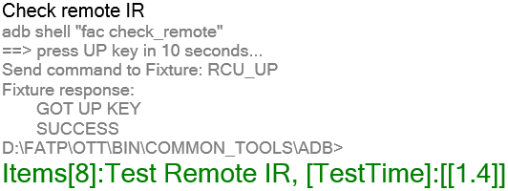
2
Fii re_check production records.
2.1 Re_check production data.
Fii re_checked production data: this unit passed all stations smoothly.
2.2 Re_check test log at FT1 station.
Test program checks RCU connection issue at item 8, FT1 station.
Fii re_checked test log at FT1 station and no found abnormal.
Remote IR tested Pass at FT1 station
Summary: After Fii rechecked production records, no found any abnormal.

Slide 4
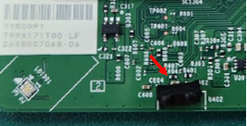
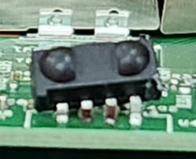
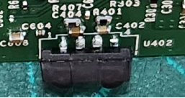
3
Root cause
As NG pictures were provided by customer, maybe someone or something was collided to U402 location lead to damage. (Because customer already opened and repaired this unit, so can’t further analysis)

Slide 5
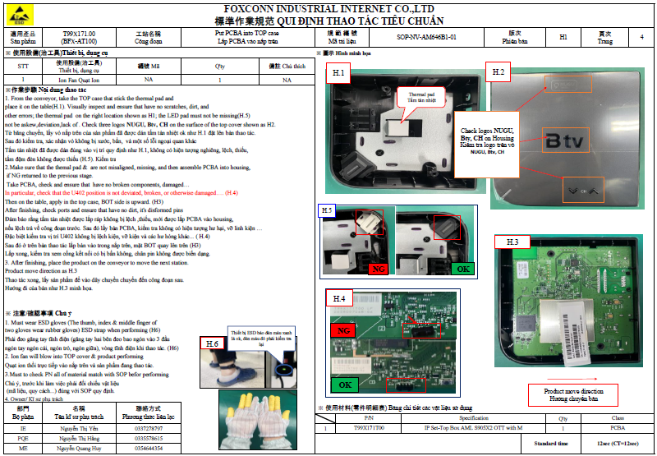
4
Action
Add NG picture from customer in SOP at assembly station, and request ASSY operators must inspect carefully at U402 location before assemble. (Done, Owner: IE Ms. Yen)

